Slide 1
LF101 Lecture 8/13 29th March 2016 Revised/updated slides
Recombinant DNA technology
Genetic Engineering

Slide 2
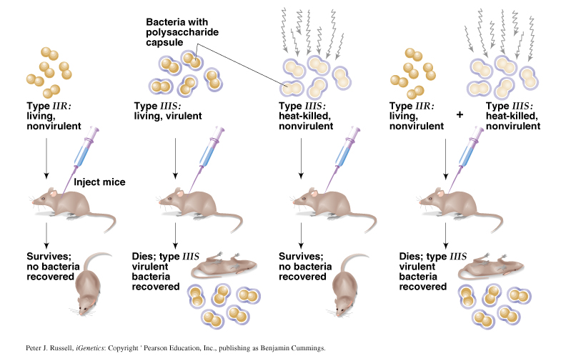
Recap:
Bacterial transformation
Griffith’s experiment
What does transformation signify?
An incoming bacterial factor (DNA ) could replace an endogenous factor
What opportunities does this observation offer?
Could an incoming DNA ( foreign gene) be made to stay in a cell?

Slide 3
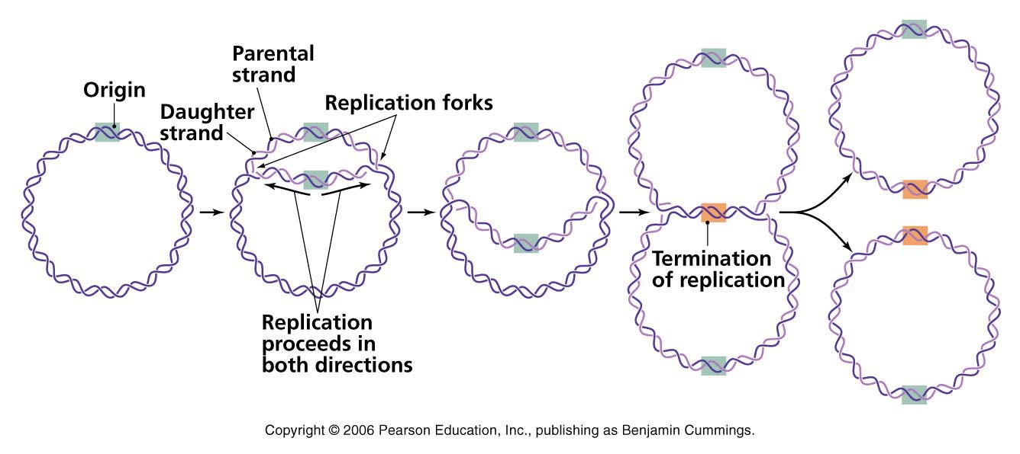
Some background information
Prokaryotes are haploid: for example, bacteria E. coli – it has only one chromosome
Bacterial chromosome is circular
Bacterial chromosome represent a single unit of replication
Bacterial cell can carry extra chromosomal replicating bodies, called plasmids
Bacterial chromosome
Plasmids

Slide 4
Transformation
Transformation
Essentially means continuation of a piece of DNA or gene in a host for generations
What are the barriers to continuity of an incoming DNA in a cell?
What is s the advantage of recombination here?
Ans: incoming DNA replicates as a part of the bacterial chormosome
Can we call this genetic engineering?
In coming DNA must replicate to continue for generations

Slide 5
Transformation by a plasmid (vector) DNA
What if the transforming DNA is a plasmid
Host bacterium
Host bacterium
Transformed by a plasmid
What if the host is actually transformed by the Plasmid DNA
The transformed host bacterium and it progeny would express the gene (marker) carried by the plasmid: for instance, antibiotic resistance
What if the plasmid (vector) DNA is made into a recombinant vector before transformation

Slide 6
Definitions of recombinant DNA (rDNA) and genetic engineering
Recombinant DNA: A new DNA molecule created by joining together two or more DNA fragments not normally associated with each other: for example a DNA from human and bacteria
Genetic engineering: The end product of genetic engineering is an organism that has been genetically modified using recombinant DNA technology without taking recourse to its natural course of mutation/ evolutionary changes etc

Slide 7


Recombinant DNA: definition
A unique piece of DNA artificially created by joining them together

Slide 8
Recombinant DNA: Vocabulary
Vector
Recombinant DNA
Restriction enzyme
Ligase
Transformation
Selection
Gene clone

Slide 9
Cloning Vectors
A cloning vector is a DNA molecule that has an origin of replication and is capable of replicating in a bacterial cell.
Most vectors are genetically engineered plasmids or phages.

Slide 10
Plasmids
What is a replicon?
Cloning vector
Plasmids: Extra-chromosomal genetic elements that are capable of autonomous replication (replicon)
What does these green area on the plasmids signify?
A marker (gene) that can be readily detected – antibiotic resistance, for example
What are the advantages of having a cloning vector
Transformation
Step 1
Step2

Slide 11
Characteristics of plasmid cloning vector :
Small size (<15Kb) for optimal efficiency of transformation in bacteria
Origin of replication-allows plasmid to replicate in the bacteria
Unique restriction enzyme sites for cloning
Carries selectable markers

Slide 12
Plasmid: it’s a circular DNA molecule containing:
a multiple cloning site or MCS
an antibiotic resistance gene
an origin of replication
MCS
ampR
Ori

Slide 13
Plasmids as a cloning vector
This is the DNA (green) that has been cloned in the plasmid vector
Origin of replication
Ampicillin resistance
A DNA vector
Self replicating
Carries selection markers

Slide 14
Two most critical enzymes for recombinant DNA technology :
Cutting enzyme: Restriction endonuclease
Stitching enzymes : Ligase
Where do we find the cutting enzyme

Slide 15
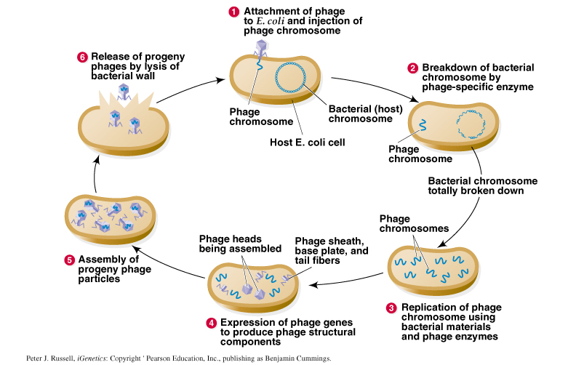
Lytic life cycle of a virulent phage, such as T2

Slide 16

Discovery of the cutting enzyme:
restriction endonuclease
Discovery of Restriction endonucleases
Host 1
Host 1
Modification
Restriction
Host 1
Modification
Methylase
Discovery of restriction-modification system
Host 1

Slide 17
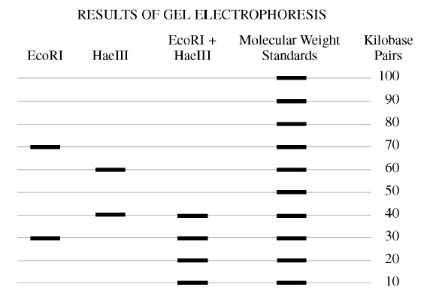
Utilities of Restriction enzyme: Precise, defined, and reproducible cuts that can be ligated again to create recombinant DNA
Results of gel electrophoresis: production of linear DNA fragments of different sizes by different restriction endonucleases
10
9
8
7
6
5
4
3
2
1
Plasmid DNA
At how many points did Eco RI restriction enzyme cut the circular plasmid DNA , at the end of the cut one finds two leaner pieces of DNA : one 7 kilo bases and the other 3 kilo bases long. What the length of the original circular plasmid DNA ?

Slide 18
Restriction Mapping
Restriction endonucleases helps build maps of linear and circular molecules
HaeII
BamHI
EcoRI
HaeIII
A plasmic
Restriction map of a plasmid
HindIII
HaeII
What is the benefit of having a restriction map for a given piece of DNA?

Slide 19
Answer the following
What are RE cuts?
Why are the RE cuts unique??
What are the utilities of the RE cuts?
What can we now do with the RE cut DNAs?

Slide 20
What are the utilities of the RE cuts?
+
G A A T T C
G A A T T C
C T T A A G
C T T A A G
Sticky ends tend to re-anneal
G A A T T C
C T T A A G

Slide 21
What can we now do with the RE cut DNAs?

Slide 22
The first cloning experiment done by Boyer and Cohen

Slide 23
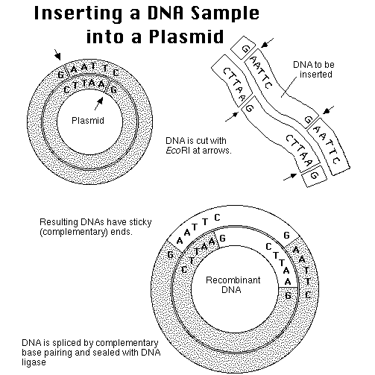
You can call this as a passenger/foreign DNA that is being carried to the bacterial host cells by the plasmid vector (carrier)

Slide 24
Basic Cloning Process
Plasmid is cut open with a restriction enzyme that leaves an overhang: a sticky end
Foreign DNA is cut with the same enzyme.
The two DNAs are mixed. The sticky ends anneal together, and DNA ligase joins them into one recombinant molecule.
The recombinant plasmids are transformed into E. coli
Cells carrying the plasmid are selected by adding an antibiotic: the plasmid carries a gene for antibiotic resistance.

Slide 25
RECAP
Plasmid and DNA cloning
Origin of replication
This is the DNA (green) that has been cloned in the plasmid vector
Ampicillin resistance
A DNA vector
Self replicating
Carries selection markers
It can be made into a recombinant DNA and thus used to clone genes
Transformed bacterial clone would then represent a gene clone as well.
Can you now tell the meaning of a gene clone?

Slide 26
Question:
If you are provided with plasmid DNA and also human DNA, will you be able to create a recombinant DNA?
Can this DNA be cloned?

